Slide 1
Love,War, and Memory
Robert Duncan, Ned Fahs, and the Crisis of World War II

Slide 2
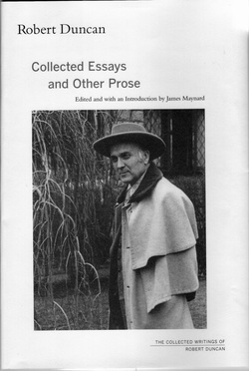
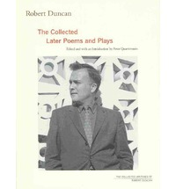

Slide 3
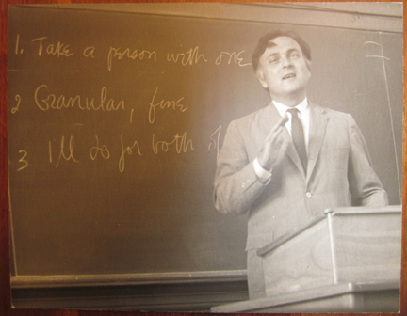

Slide 4
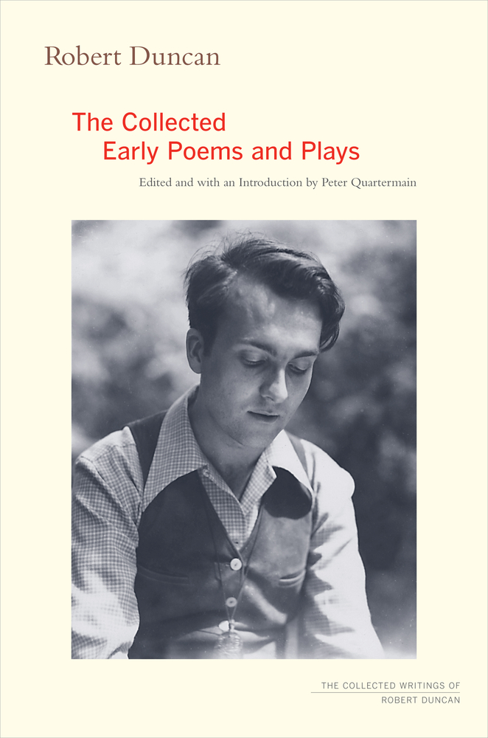

Slide 5
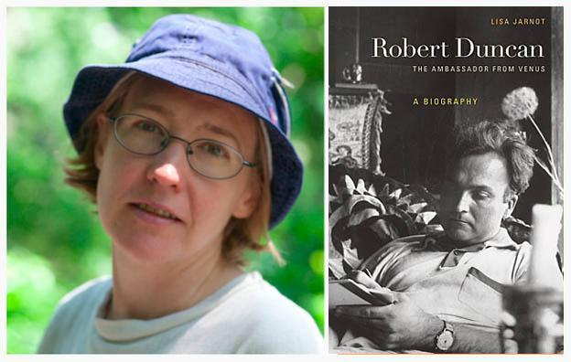
Poet Lisa Jarnot, author of The Ambassador from Venus

Slide 6
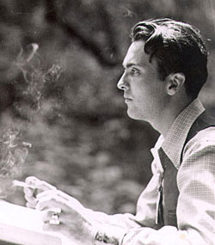

Slide 7
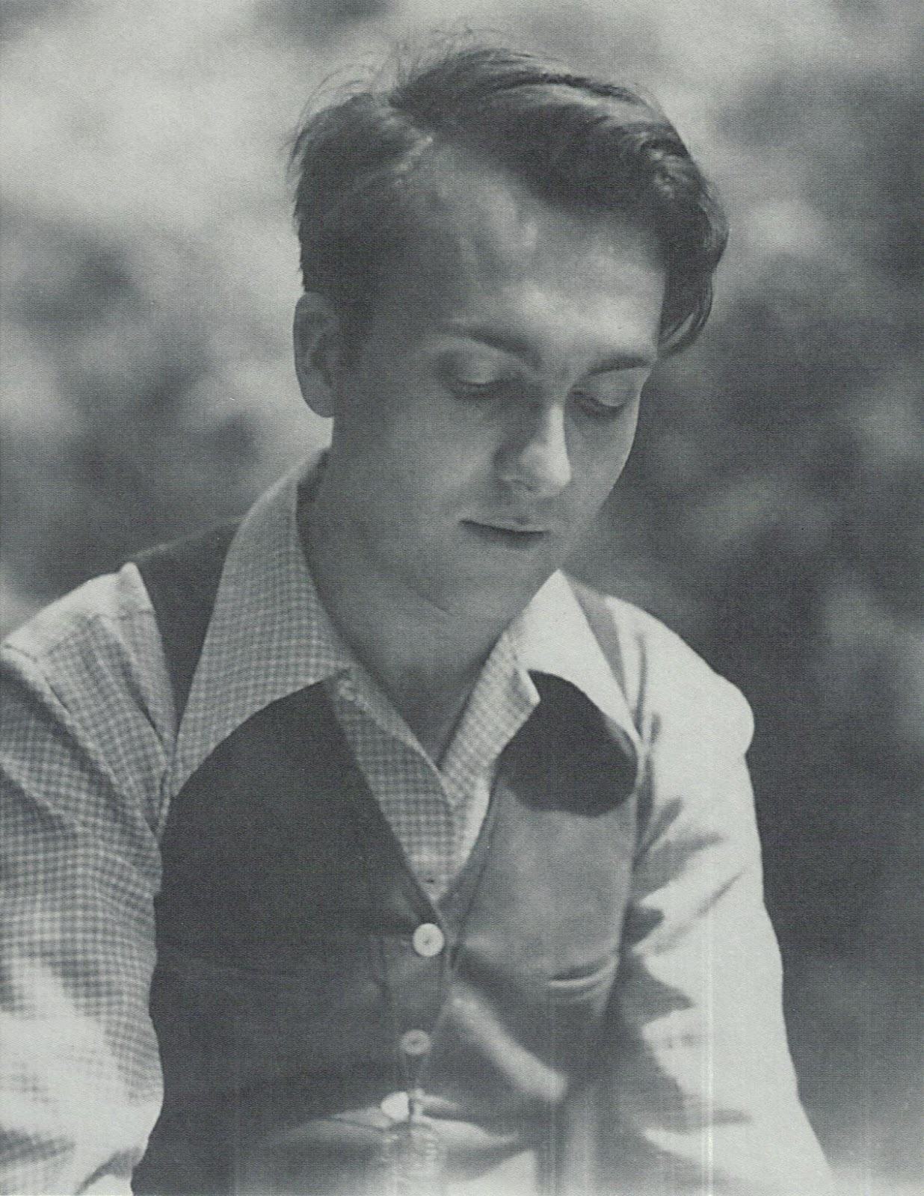

Slide 8


Slide 9
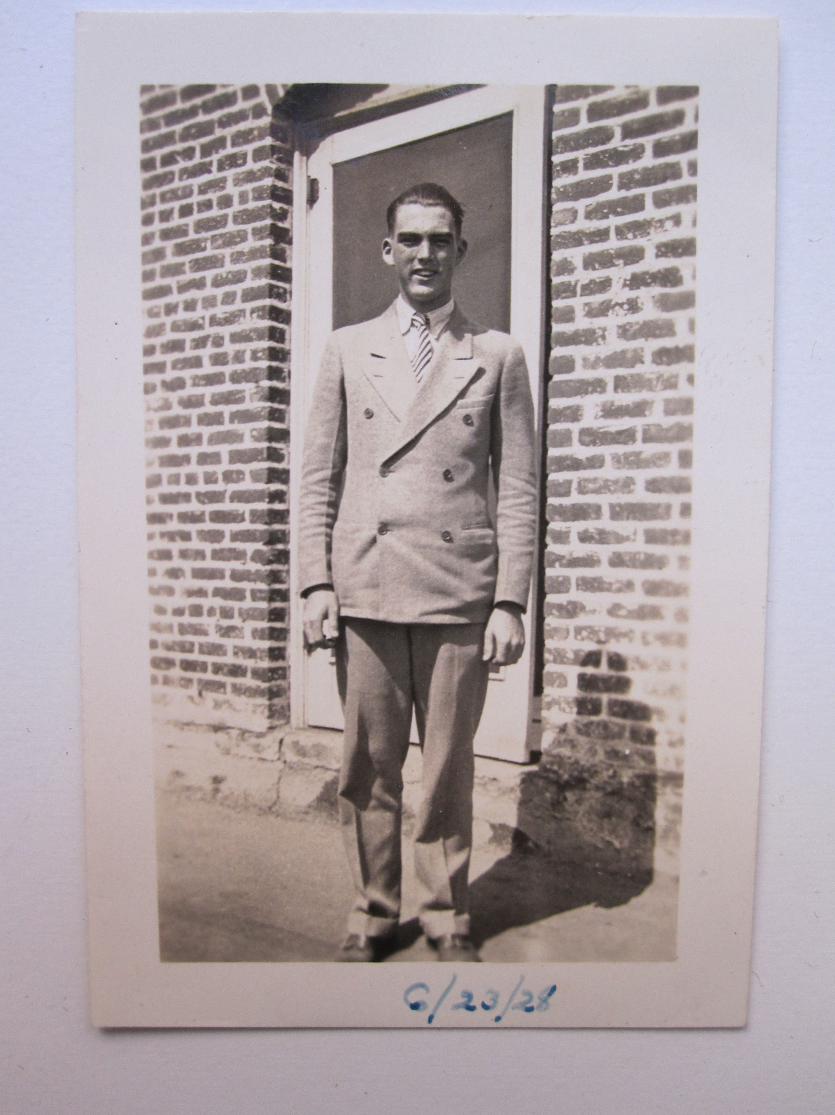

Slide 10
Robert Duncan
with Admiral Togo in Annapolis, 1940

Slide 11
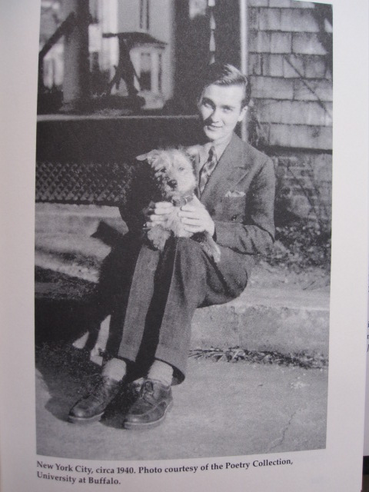

Slide 12
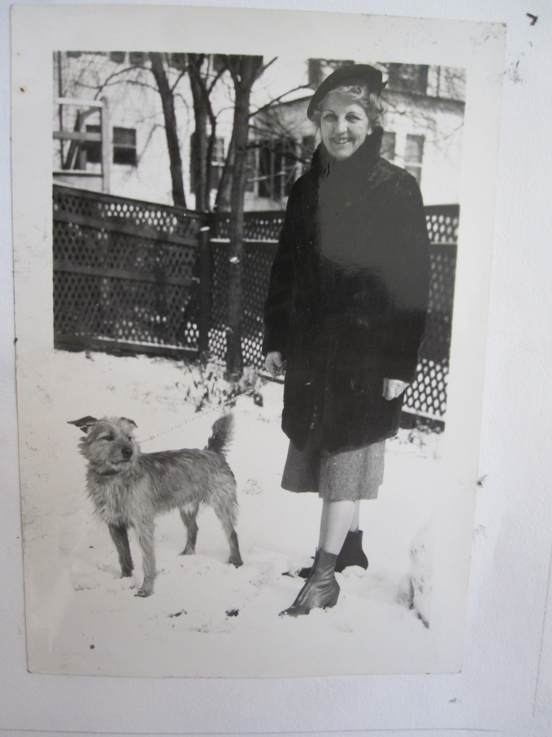

Slide 13
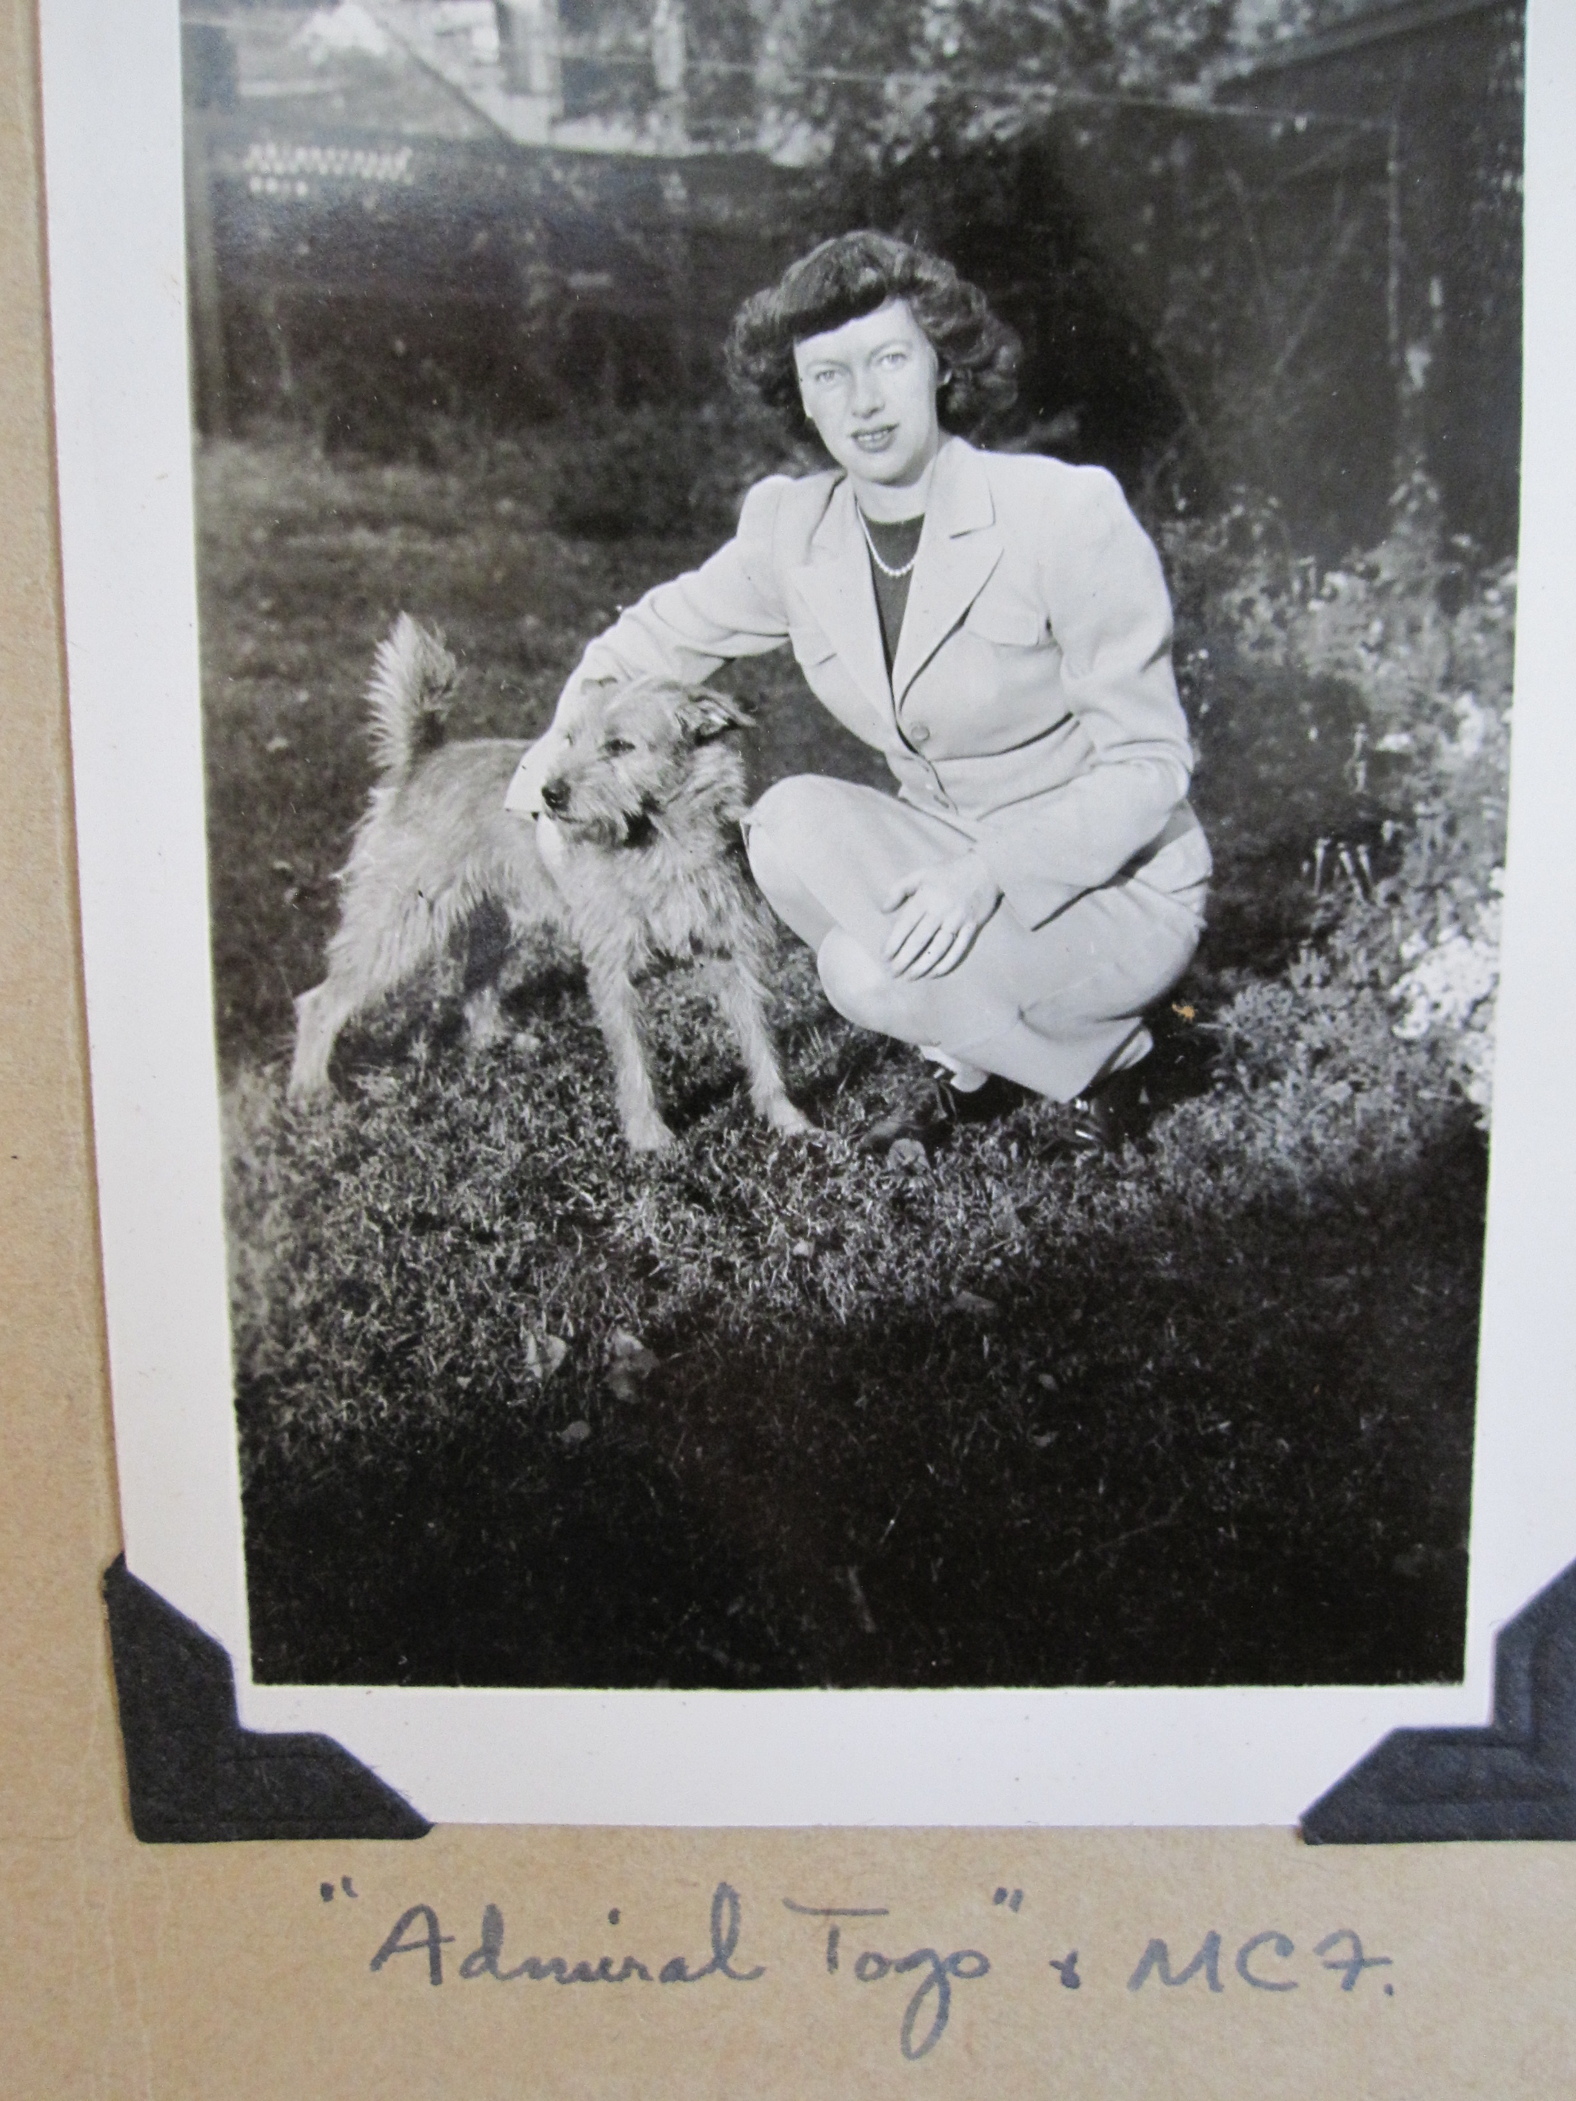

Slide 14
Robert Duncan,
September 1939

Slide 15
Robert Duncan,
September 1939

Slide 16
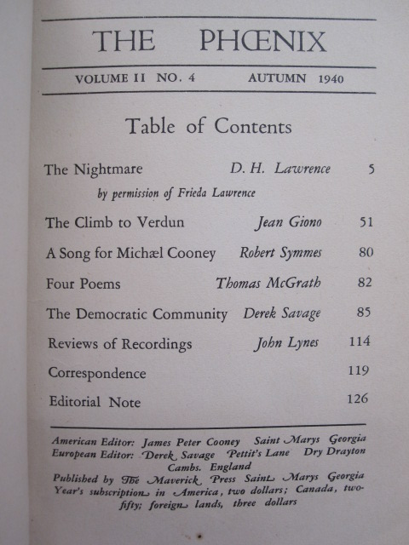

Slide 17
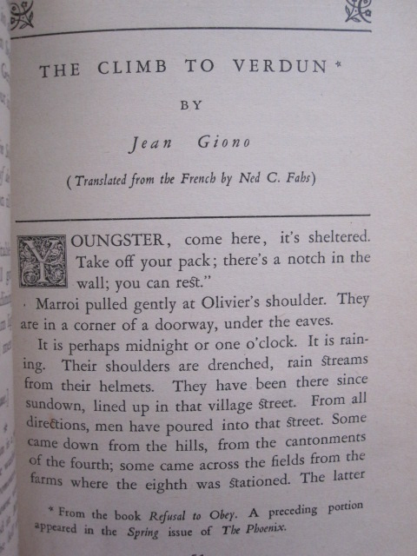

Slide 18
The unknown man, Box 13, Robert Duncan Papers, University of Buffalo Poetry Collection

Slide 19
Unknown man #2,
Box 13, University of Buffalo Poetry Collection

Slide 20
Robert Duncan,
September 1939

Slide 21
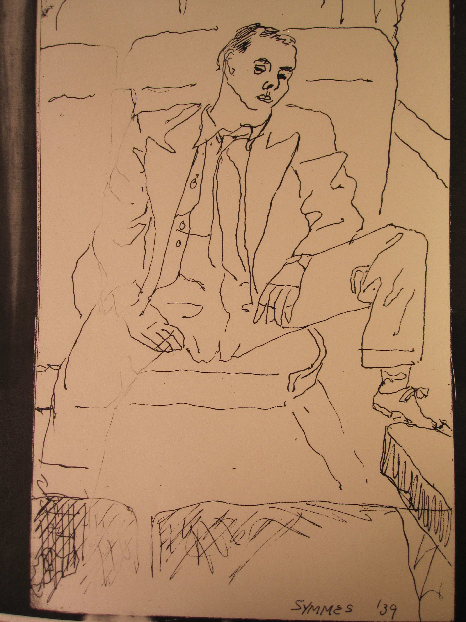

Slide 22
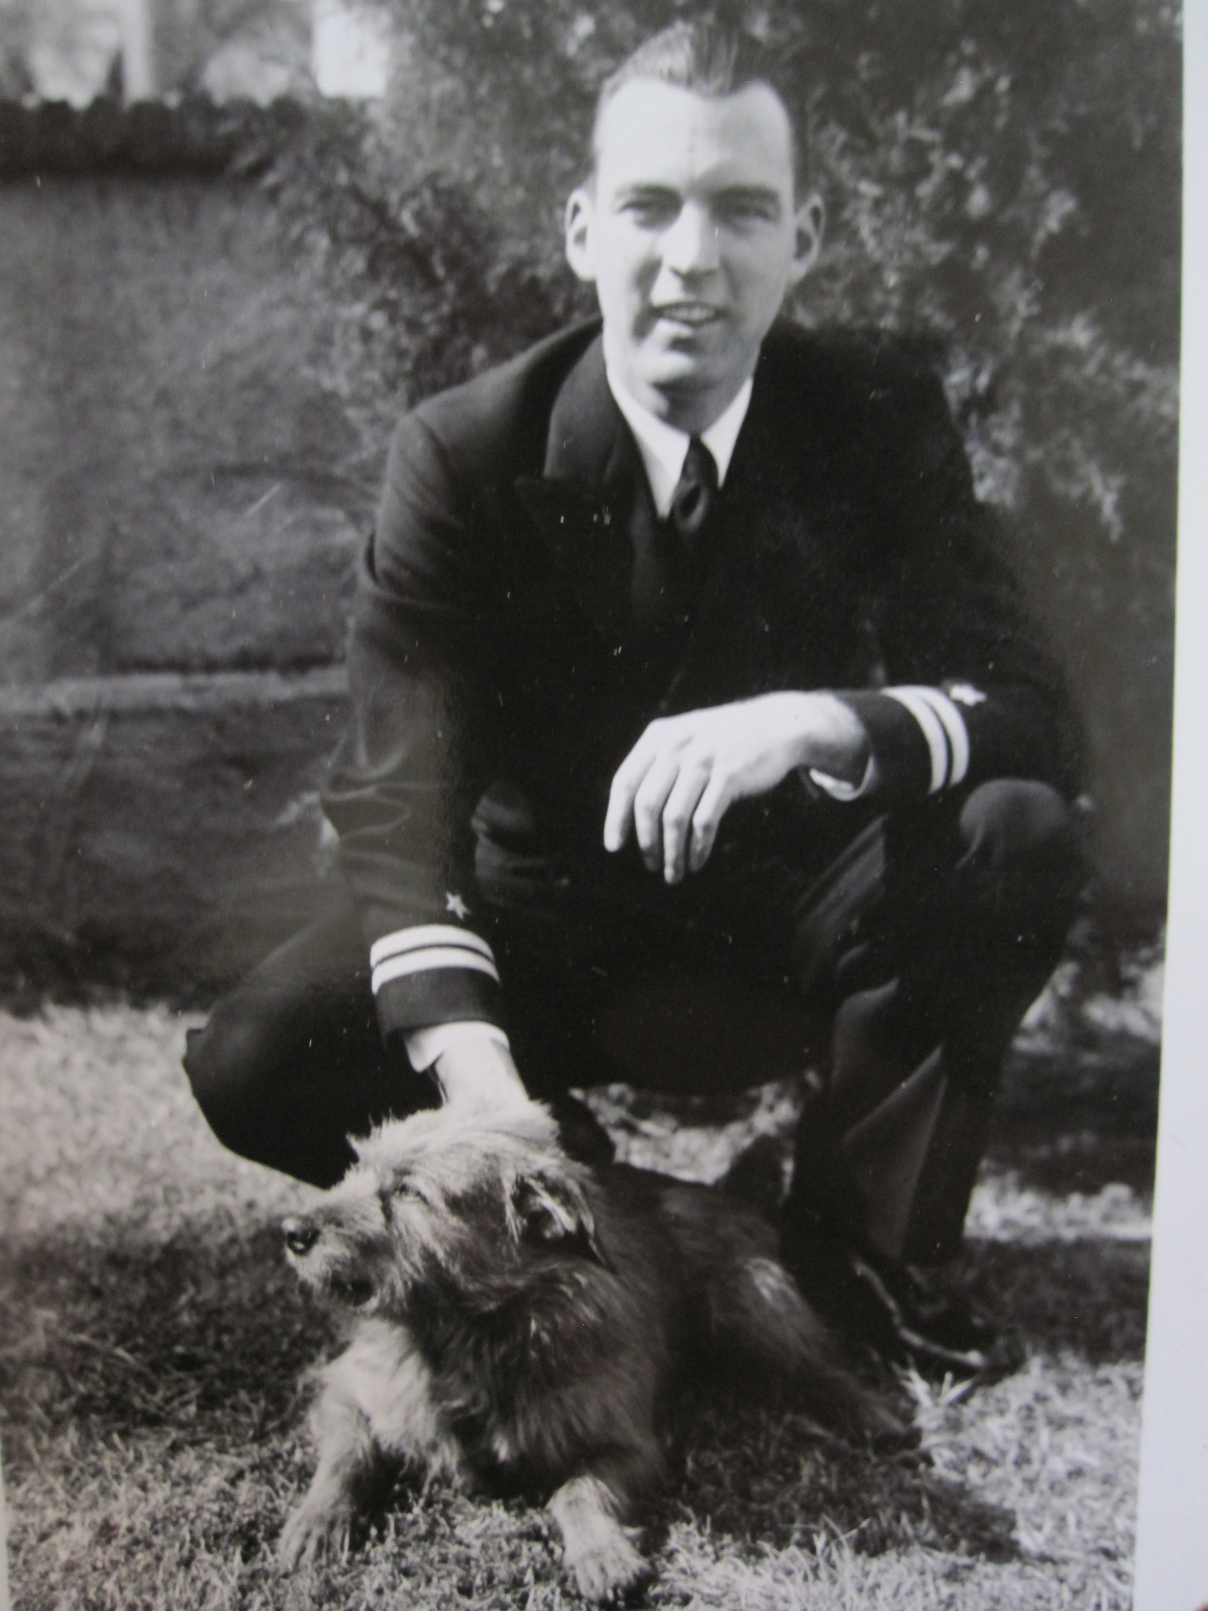

Slide 23
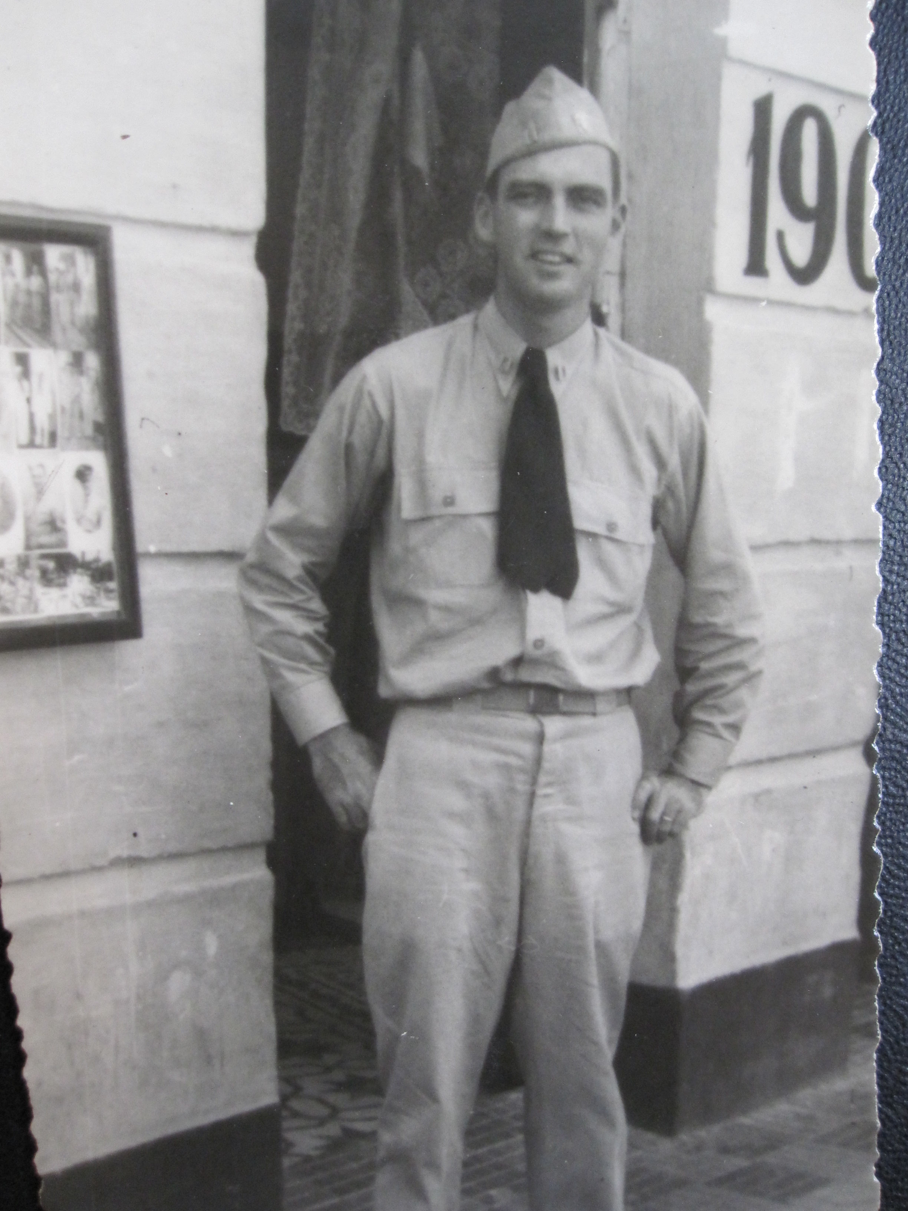

Slide 24
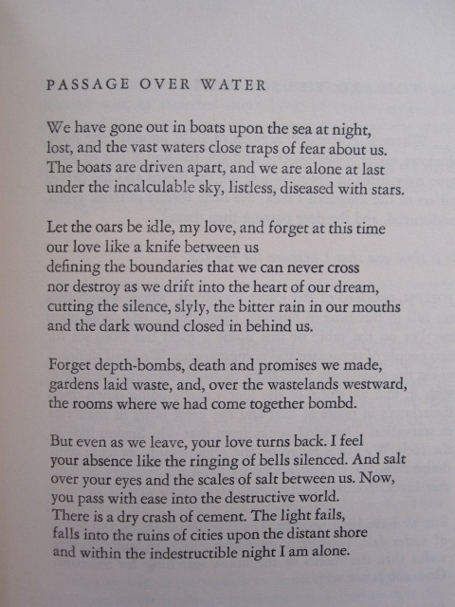

Slide 25
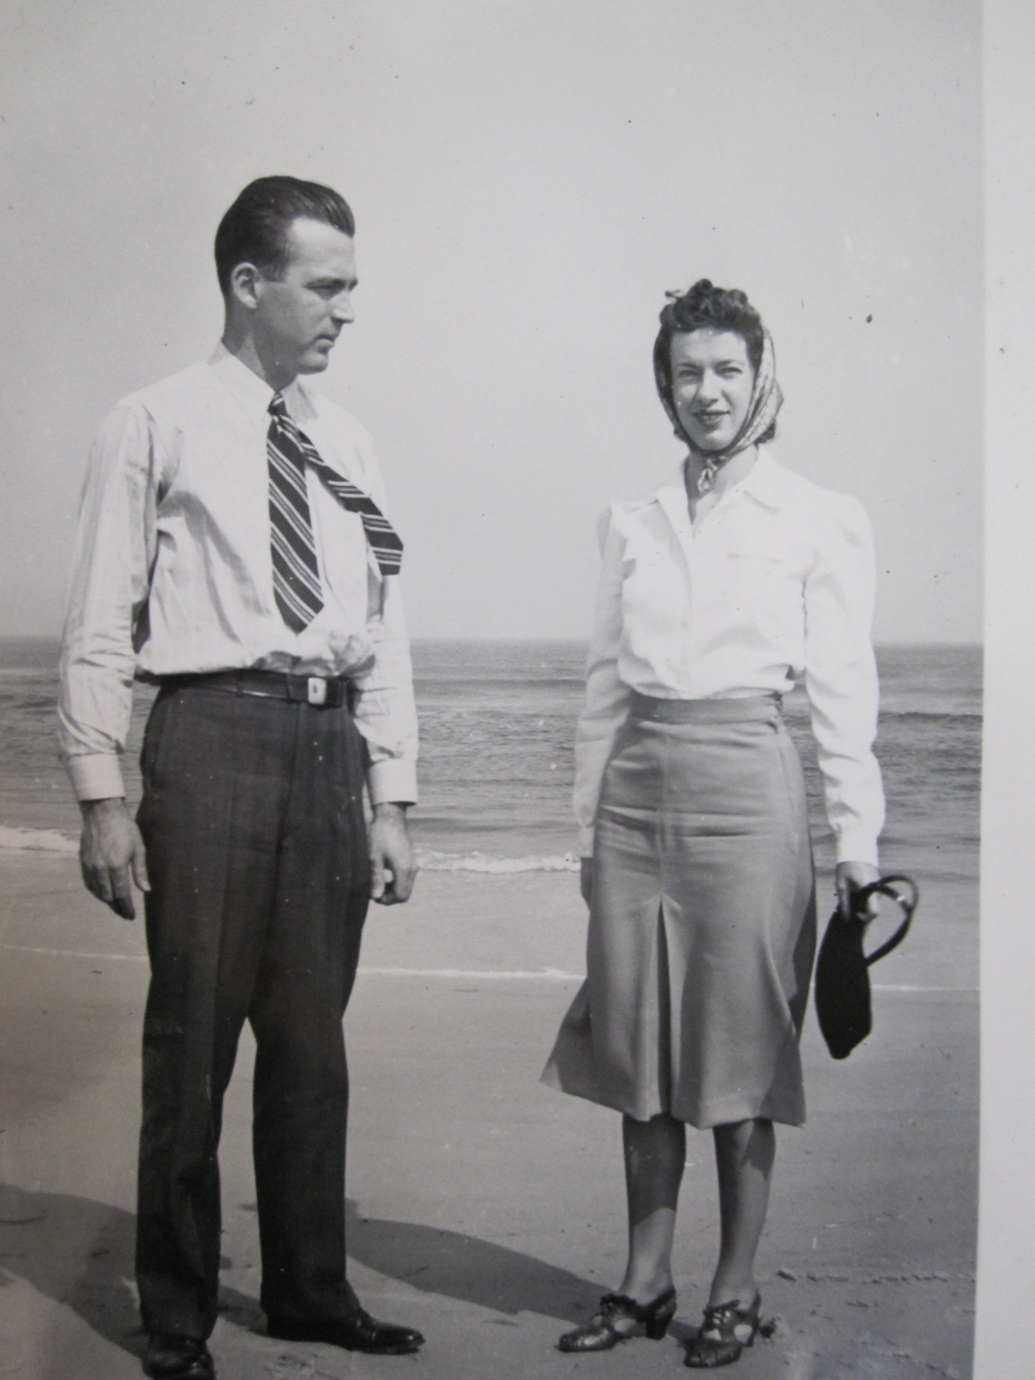

Slide 26
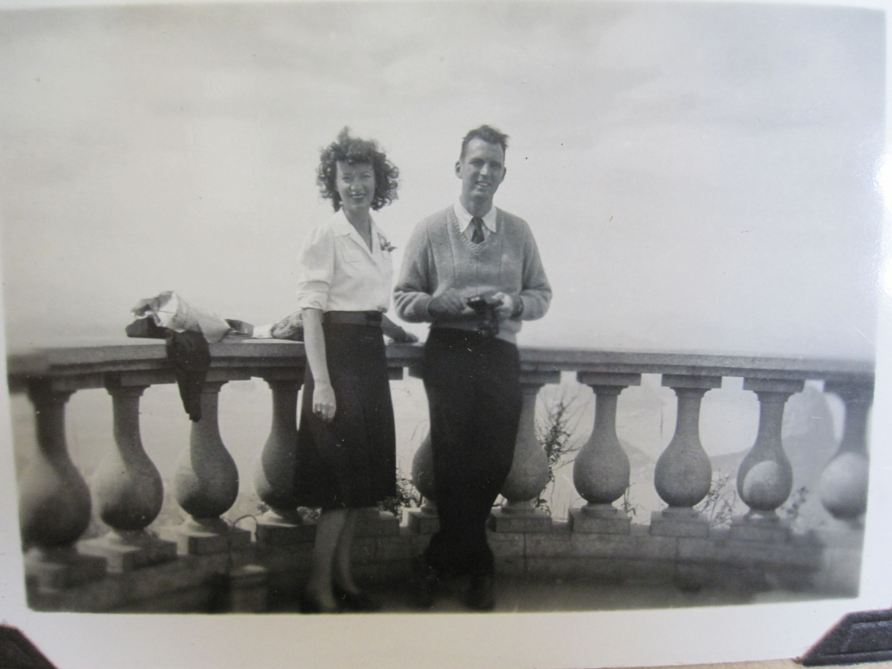

Slide 27
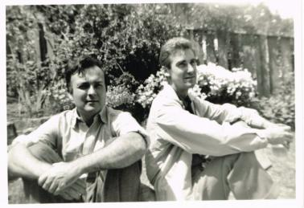
Robert Duncan and Jess, 1959

Slide 28
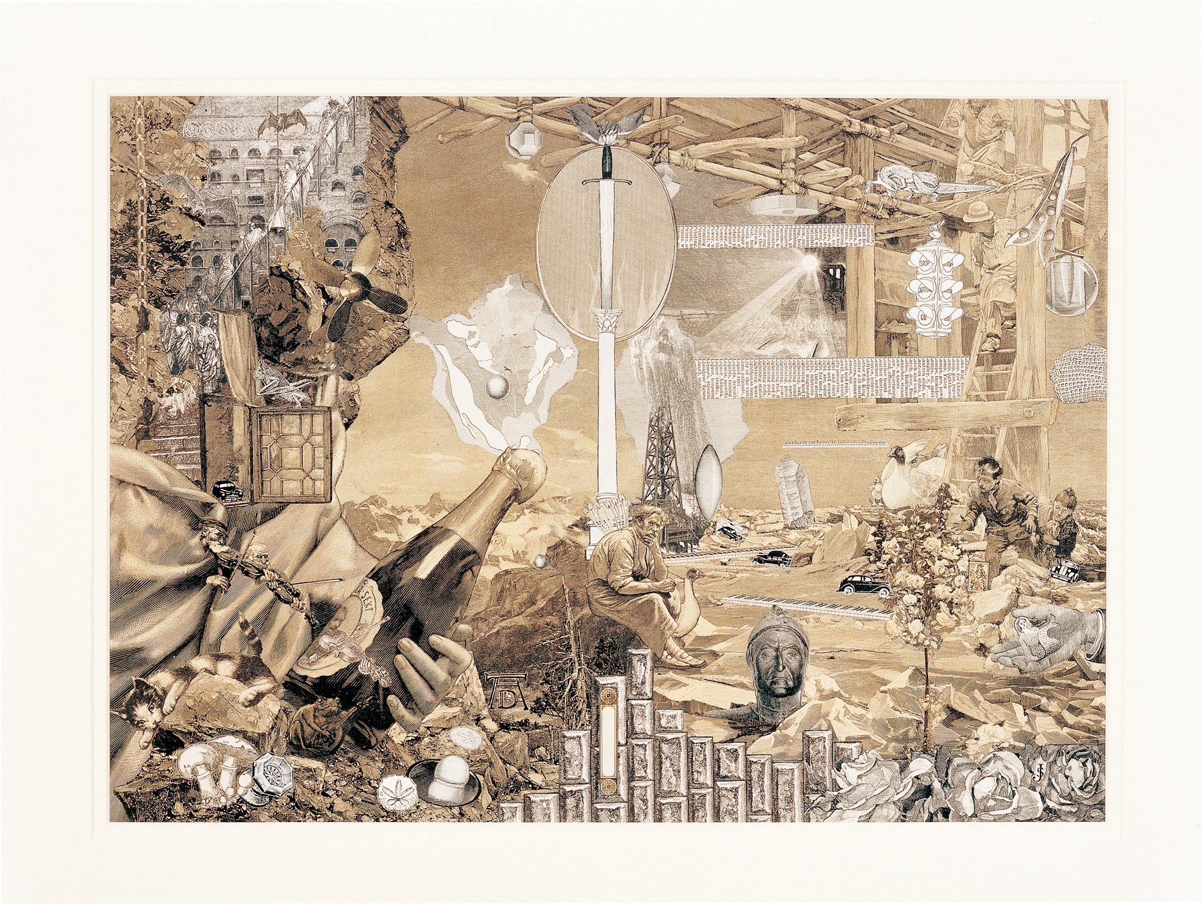

Slide 29
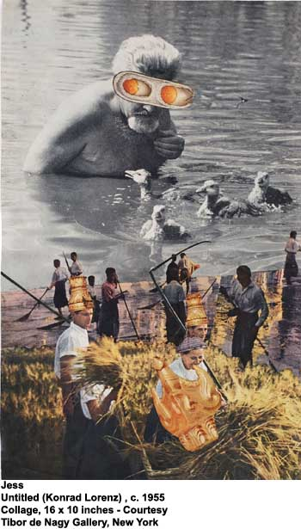

Slide 30
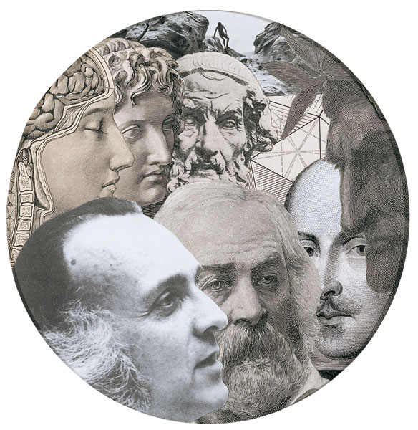
Jess, Emblems
For Robert Duncan,
1989

Slide 31
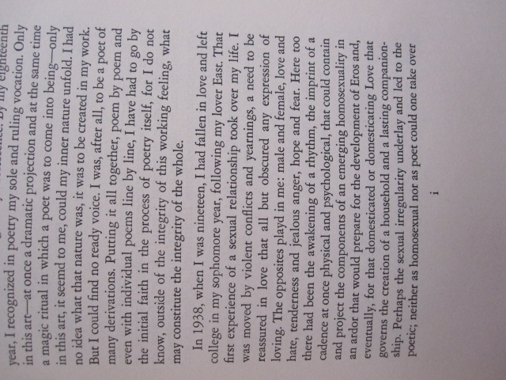
Robert Duncan,
Preface,
The Years As
Catches, 1966

Slide 32
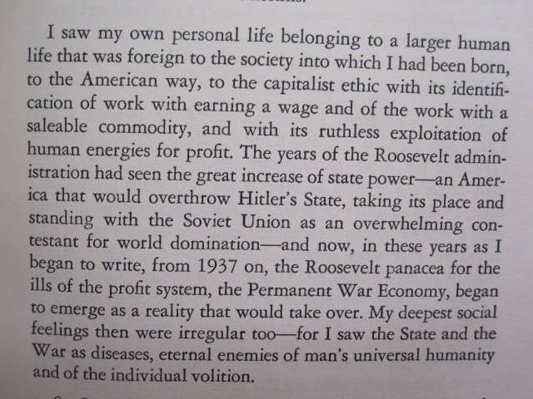
From the Preface to The Years As Catches, 1966

Slide 33
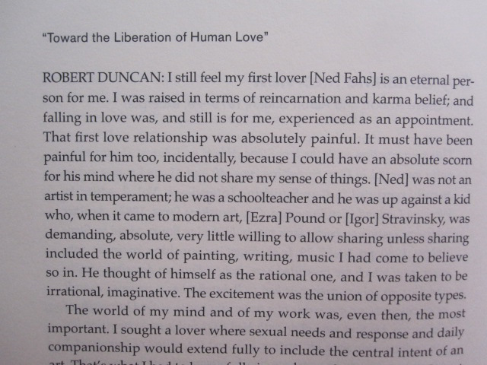
Gay Sunshine Interview, 1978-1979

Slide 34
THE STRUCTURE OF RIME XI
There are memories everywhere then. Rememberd, we go
out, as in the first poem, upon the sea at night--to the drifting.
Of my first lover there is a boat drifting. The oars have been cast
down into the shell. As if this were no water but a wall, there is
a repeated knock as of hollow against hollow, wood against
wood. Stooping to knock on wood against the traps of the night-
fishers, I hear before my knocking the sound of a knock drifting.
It goes without will thru the perilous sound a white sad wan-
derer where I no longer am. It taps at the posts of the deserted
wharf.
Now from the last years of my life I hear forerunners of a
branch creaking.
All night a boat swings as if to sink. Weight returning to weight
in the cold water. A hotel room returns from Wilmington into
morning. A boat sets out without boatmen into twenty years of
snow returning.

Slide 35

“Structure of Rime 11,” Robert Duncan reading in Vancouver, British Columbia, July 26, 1963

Slide 36
“Structure of Rime 11,” Robert Duncan reading, Berkeley Poetry Conference, 1965

Slide 37
Often I Am Permitted to Return to a Meadow
as if it were a scene made-up by the mind,
that is not mine, but is a made place,
that is mine, it is so near to the heart,
an eternal pasture folded in all thought
so that there is a hall therein
that is a made place, created by light
wherefrom the shadows that are forms fall.
Wherefrom fall all architectures I am
I say are likenesses of the First Beloved
whose flowers are flames lit to the Lady.

Slide 38
She it is Queen Under The Hill
whose hosts are a disturbance of words within words
that is a field folded.
It is only a dream of the grass blowing
east against the source of the sun
in an hour before the sun’s going down
whose secret we see in a children’s game
of ring a round of roses told.
Often I am permitted to return to a meadow
as if it were a given property of the mind
that certain bounds hold against chaos,
that is a place of first permission,
everlasting omen of what is.

Slide 39
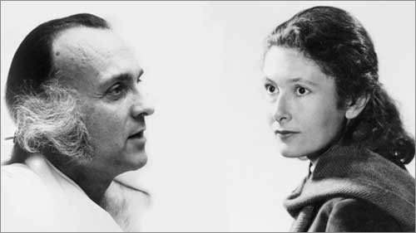
Robert Duncan, Denise Levertov, and the question of protest against the Vietnam War

Slide 40
